Slide 1
HireAC
YOUR HOW TO GUIDE

Slide 2
HireAC Guide Sections
Getting Started with HireAC
Cooperative Education Module in HireAC
Changing Preferred Name in HireAC
Downloading the Co-op Work Permit Confirmation Letter
Co-op Documents Page in HireAC
Co-op Job Postings Page in HireAC
Setting up Job Alerts in HireAC
Co-op Interviews Page in HireAC
Co-op Job Offers in HireAC
Co-op Work-term record in HireAC
Booking a Peer Review meeting in HireAC
Events And Workshops Module in HireAC
Career & Employment Module in HireAC

Slide 3
2. Cooperative Education Module in HireAC
Home page and other key sections of the Cooperative Education module

Slide 4
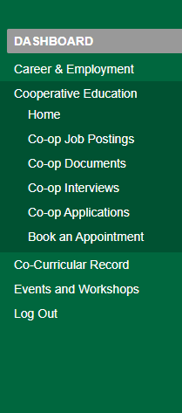
Cooperative Education Module in HireAC
Go to Cooperative Education! As a Co-op student, you will be using the Cooperative Education module throughout your Co-op journey at Algonquin College.
This is the module that you will be using during the Co-op Job Search term to view and apply to Co-op jobs for your program of study, upload your documents, and schedule interviews with employers.
If you secure a Co-op job, you will also continue to use this module during the Co-op work-term to manage your Co-op work term assignments that are submitted through HireAC.

Slide 5
Cooperative Education Module – Key Sections
Co-op Job Postings page is where you will find and apply to Co-op opportunities posted for your program of study.
Co-op Documents page is where you will upload your resume and cover letter and create application packages for specific Co-op roles. You can also view the Co-op Resume Gallery for examples of resumes from past Co-op students.
Co-op Interviews page is where you will manage interview invitations and view interview details.
Co-op Job Applications page provides a record of all job applications you submitted for your scheduled Co-op work term.
Book an Appointment page is where you can book a 30-minute Peer Review meeting with the Co-op and Career Leader student working at the Co-op and Career Centre to review your resume or cover letter and practice interview skills.
Rankings page is where you will receive job offers if you are ranked as a top candidate after the interviews.

Slide 6
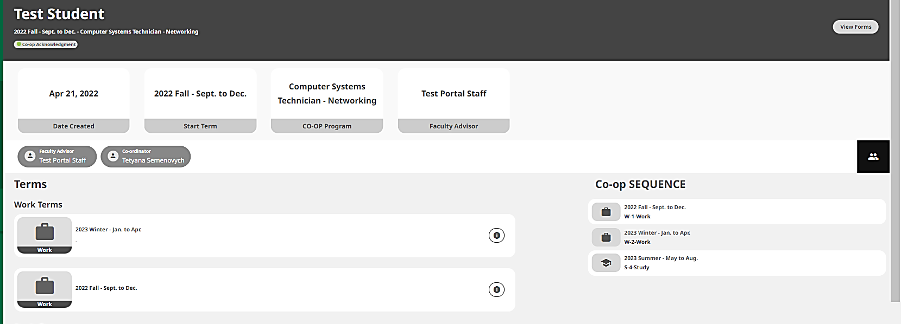
Home Page of the Cooperative Education Module
The Home page of the Co-op module includes the following information:
Your Co-op Sequence page explains your academic/co-op work term schedule established by your academic department.
Coordinator details will refer you to your Co-op Student Advisor, who is your main point of contact in the Co-op and Career Centre for support throughout your entire Co-op experience at Algonquin College.

